Slide 1

Programming in C

Slide 2
Introduction
C is the famous programming language designed to develop system application program.
It is known as the starting of every programming language all the basics of a program language starts from C language
C is known as general purpose procedural programming language.

Slide 3
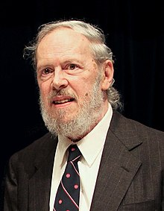
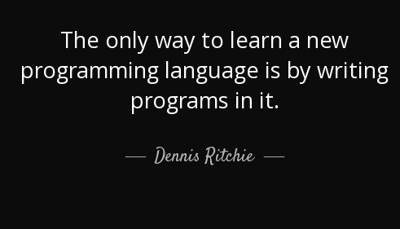
History
C, computer programming language developed in the early 1970s by American computer scientist Dennis M. Ritchie at Bell Laboratories (formerly AT&T Bell Laboratories).

Slide 4

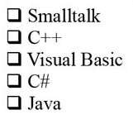
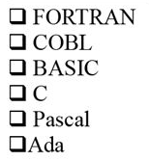
Computer Program
Computer programs can be written in high and low level languages, depending on the task and the hardware being used.
Object Oriented
High Level
Procedural
Assembly Language
Low Level
Machine Language
Hardware

Slide 5
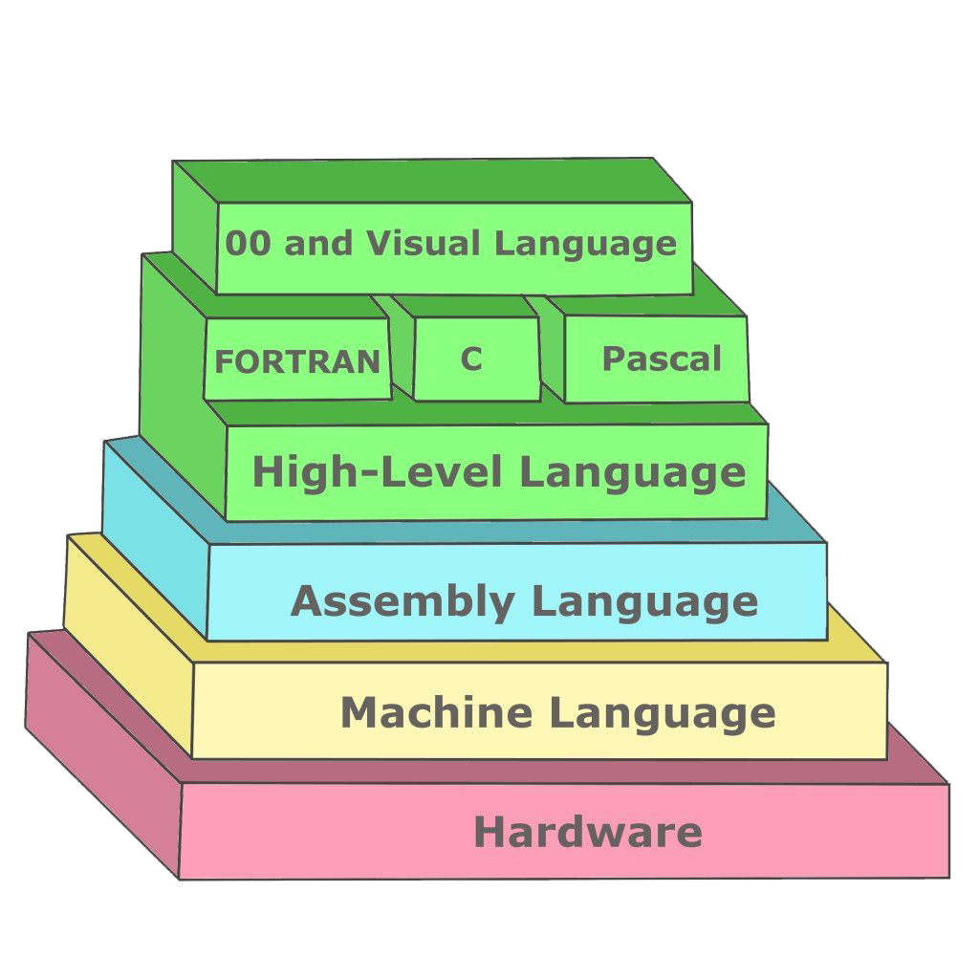
High-level language
It can be considered as a programmer-friendly language.
It is easy to understand.
It is easy to debug.
It requires a compiler/interpreter to be translated into machine code.
It can be run on different platforms.
Examples of high level languages include C, C++, Java, Python.
It is less memory efficient.
It is used widely in today's times.
Low-level language
It is considered as a machine-friendly language.
It requires an assembler that would translate instructions.
It is not portable.
It is difficult to understand.
It is difficult to debug.
It consumes less memory.
It is not used widely in today's times.

Slide 6
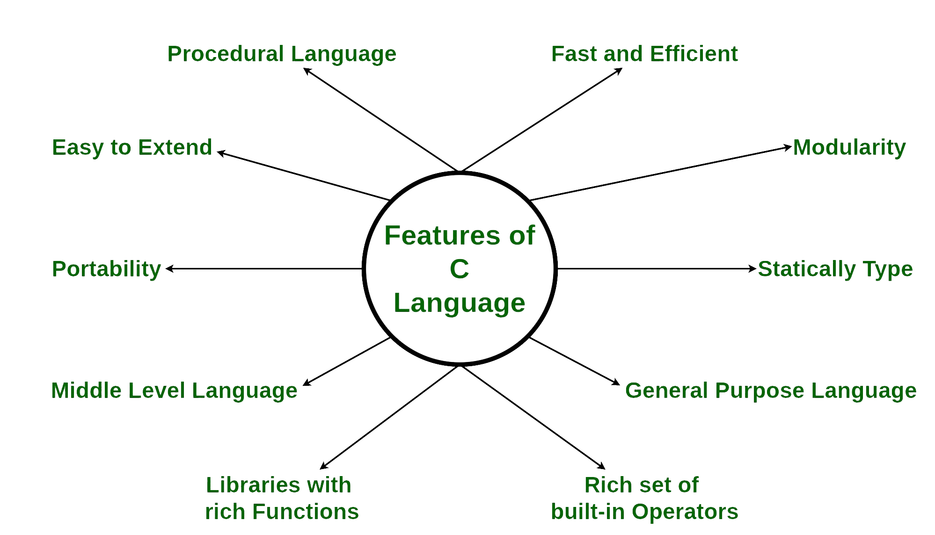
Features of C Programming Language
Note: C Programming language is called as Middle Level Language because
It gives or behaves as High Level Language through Functions.
It gives access to the low level memory through Pointers.

Slide 7
Advantages of C
C is the building block for many other programming languages.
Programs written in C are highly portable.
Several standard functions are there (like in-built) that can be used to develop programs.
C programs are collections of C library functions, and it's also easy to add functions to the C library.
The modular structure makes code debugging, maintenance, and testing easier.
Disadvantages of C
C does not provide Object Oriented Programming (OOP) concepts.
There are no concepts of Namespace in C.
C does not provide binding or wrapping up of data in a single unit.
C does not provide Constructor and Destructor.

Slide 8
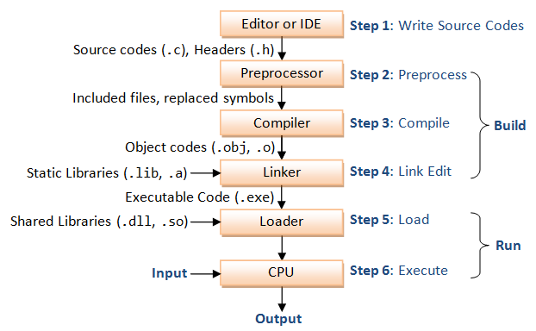
How C Programming Language Works?
C is a compiled language. A compiler is a special tool that compiles the program and converts it into the object file which is machine readable. After the compilation process, the linker will combine different object files and creates a single executable file to run the program. The following diagram shows the execution of a 'C' program.
Nowadays, various compilers are available online, and you can use any of those compilers. The functionality will never differ and most of the compilers will provide the features required to execute both 'C' and 'C++' programs.
Following is the list of popular compilers available online.
Clang compiler
MinGW compiler (Minimalist GNU for Windows)
Portable 'C' compiler
Turbo C

Slide 9
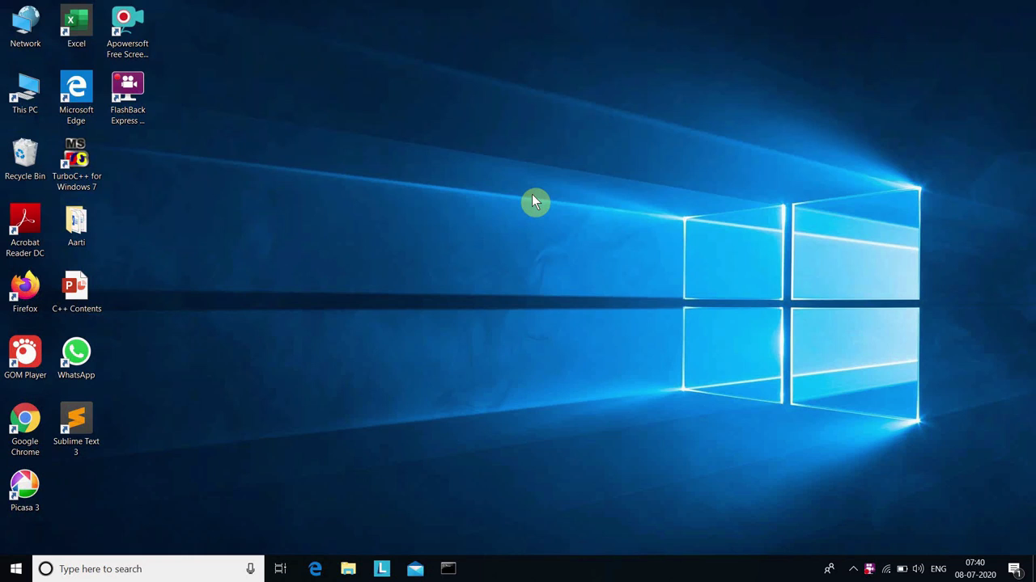
Installation of Dev c++

Slide 10
Structure of a C program

Slide 11
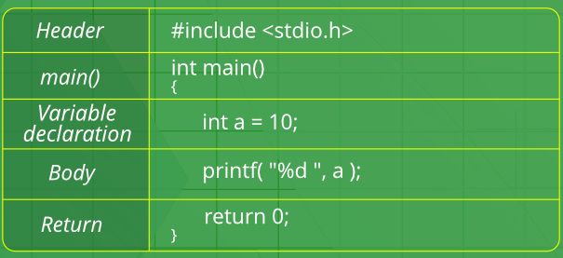





Structure of a C program
After the above discussion, we can formally assess the structure of a C program. By structure, it is meant that any program can be written in this structure only. Writing a C program in any other structure will hence lead to a Compilation Error.
The structure of a C program is as follows:

Slide 12

Header Files Inclusion: The first and foremost component is the inclusion of the Header files in a C program. A header file is a file with extension .h which contains C function declarations and macro definitions to be shared between several source files.
Some of C Header files:
stddef.h – Defines several useful types and macros.
stdint.h – Defines exact width integer types.
stdio.h – Defines core input and output functions
stdlib.h – Defines numeric conversion functions, pseudo-random network generator, memory allocation
string.h – Defines string handling functions
math.h – Defines common mathematical functions

Slide 13
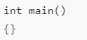
Main Method Declaration: The next part of a C program is to declare the main() function. C programs are divided into units called functions. Irrespective of the number of functions in a program the operating system always passes control to main() when a C program is executed. The function name always followed by parentheses. The parentheses may or may not contain parameters.
The syntax to declare the main function is:
Syntax to Declare the main method:
Parentheses
Delimiters

Slide 14
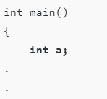
Variable Declaration: The next part of any C program is the variable declaration. It refers to the variables that are to be used in the function. Please note that in the C program, no variable can be used without being declared. Also in a C program, the variables are to be declared before any operation in the function.

Slide 15
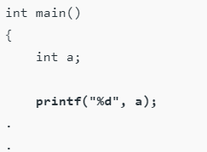
Body: The body of a function in the C program, refers to the operations that are performed in the functions. It can be anything like manipulations, searching, sorting, printing, etc.

Slide 16
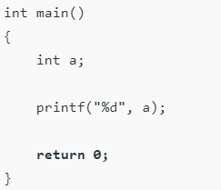
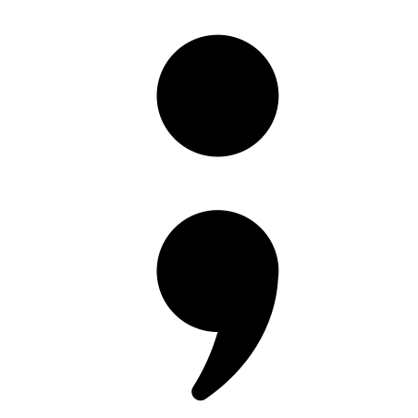
Return Statement: The last part of any C program is the return statement. The return statement refers to the returning of the values from a function. This return statement and return value depend upon the return type of the function.
For example, if the return type is void, then there will be no return statement. In any other case, there will be a return statement and the return value will be of the type of the specified return type.
Note: A statement in C is terminated as a Semicolon

Slide 17
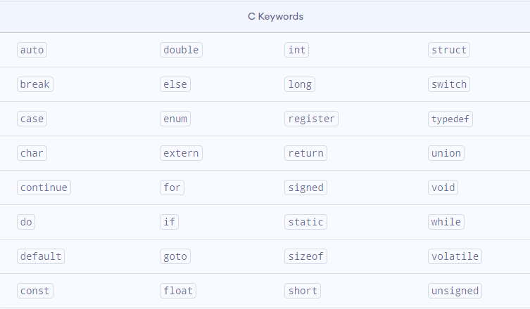
C Keywords
Keywords are predefined, reserved words used in programming that have special meanings to the compiler. Keywords are part of the syntax and they cannot be used as an identifier. For example
Here, int is a keyword that indicates is a variable of type int (integer).
As C is a case sensitive language, all keywords must be written in lowercase. Here is a list of all keywords allowed in ANSI C.(American National Standards Institute)

Slide 18
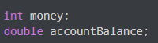
C Identifiers
Identifier refers to name given to entities such as variables, functions, structures etc.
Identifiers must be unique. They are created to give a unique name to an entity to identify it during the execution of the program. For example:
Here, money and accountBalance are identifiers.
Also remember, identifier names must be different from keywords. You cannot use int as an identifier because int is a keyword.

Slide 19
Rules for naming identifiers
A valid identifier can have letters (both uppercase and lowercase letters), digits and underscores.
The first letter of an identifier should be either a letter or an underscore.
You cannot use keywords like int , while etc. as identifiers
There is no rule on how long an identifier can be. However, you may run into problems in some compilers if the identifier is longer than 31 characters.
Note: You can choose any name as an identifier if you follow the above rule, however, give meaningful names to identifiers that make sense.

Slide 20
Variables & Constants

Slide 21
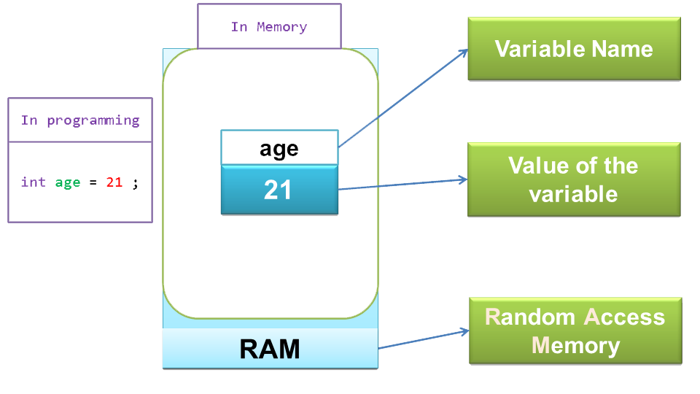
Variables
In programming, a variable is a container (storage area) to hold data.
To indicate the storage area, each variable should be given a unique name(identifier).
Variable names are just the symbolic representation of a memory location. For example:
int age = 21
Here, age is a variable of int type. Here, the variable is assigned an integer value 21.

Slide 22
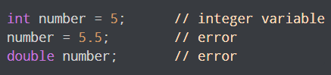
Rules for naming a variable
A variable name can only have letters (both uppercase and lowercase letters), digits and underscore.
The first letter of a variable should be either a letter or an underscore.
There is no rule on how long a variable name (identifier) can be. However, you may run into problems in some compilers if the variable name is longer than 31 characters.
C is a strongly typed language. This means that the variable type cannot be changed once it is declared. For example:
Note: You should always try to give meaningful names to variables. For example: firstName is a better variable name than fn

Slide 23
Literals
Literals are data used for representing fixed values. They can be used directly in the code.
For example: 1 , 2.5 , ’c’ etc.
Integers
Floating-point Literals
Characters
Escape Sequences
String Literals

Slide 24
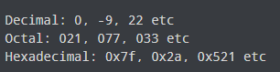
1.Integers
An integer is a numeric literal(associated with numbers) without any fractional or exponential part. There are three types of integer literals in C programming:
decimal (base 10)
octal (base 8)
hexadecimal (base 16)
For Example
In C programming, octal starts with a 0, and hexadecimal starts with a 0x.

Slide 25
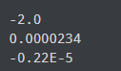
2.Floating-point Literals
A floating-point literal is a numeric literal that has either a fractional form or an exponent form.
For Example

Slide 26
3. Characters
A character literal is created by enclosing a single character inside single quotation marks.
For Example : 'a', 'm', 'F', '2', '}' etc.

Slide 27
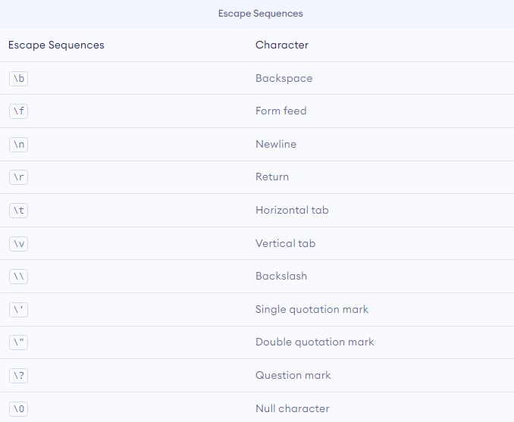
4. Escape Sequences
Sometimes, it is necessary to use characters that cannot be typed or has special meaning in C programming. For example: newline(enter), tab, question mark etc.
In order to use these characters, escape sequences are used.
For example: \n is used for a newline. The backslash \ causes escape from the normal way the characters are handled by the compiler.

Slide 28
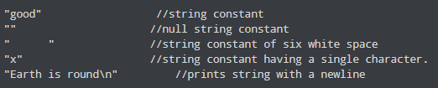
5. String Literals
A string literal is a sequence of characters enclosed in double-quote marks.
For Example :

Slide 29
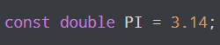
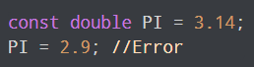
Constants
If you want to define a variable whose value cannot be changed, you can use the const. keyword. This will create a constant. For example,
Notice, we have added keyword const.
Here, PI is a symbolic constant; its value cannot be changed.

